Slide 2
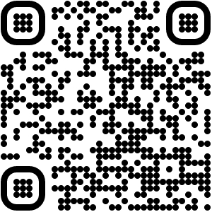
Scan QR code with your camera to sign-in.

Slide 3
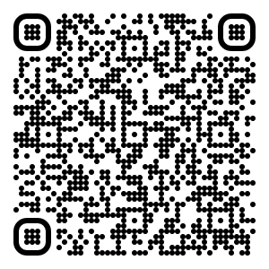
Scan QR code with your camera to download agenda.

Slide 4
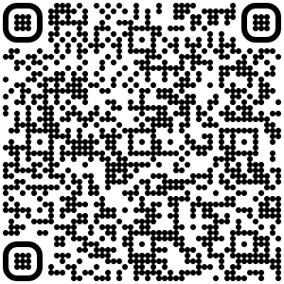
Scan QR code with your camera to complete the survey.

